Slide 1

Cameco
Adrian Remigio · Emily Cao · Thu Nguyen · Tyler Hoang · Brian Banh
01 · Company Overview
02 · Financials
03 · Valuation
04 · Catalysts
05 · Risks & Conclusion
Notes:
Title slide. Lead with CCJ as a BUY. All figures sourced from FY2025 audited filings (Cameco reports in CAD under IFRS as a Canadian issuer).

Slide 2
01
Company Overview
& Business Model

Slide 3
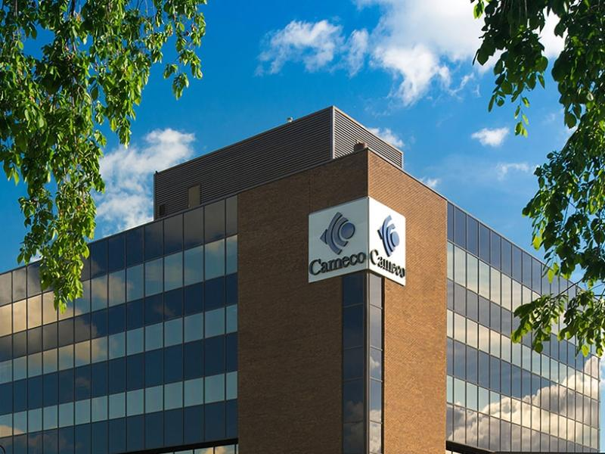
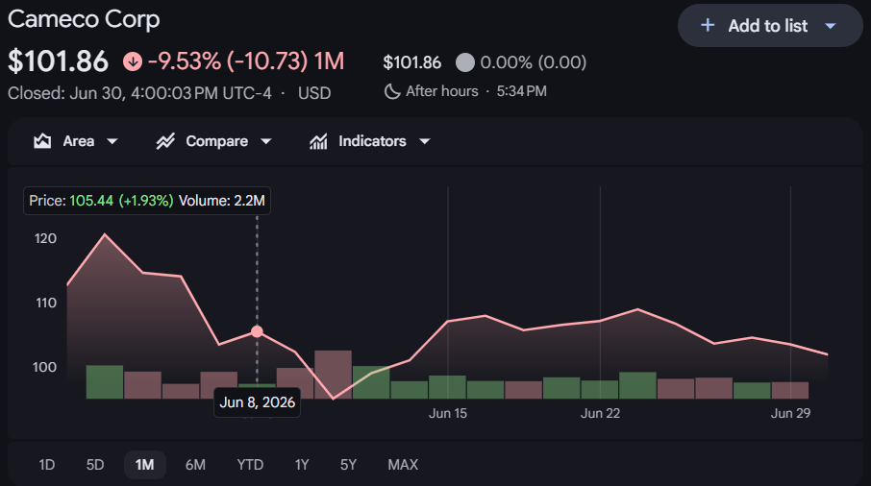
01 · COMPANY OVERVIEW
Cameco (NYSE:CCJ, TSX: CCO)
Headquarters
Saskatoon, Saskatchewan, Canada
Sector: Industry
Energy: Uranium and Nuclear Power
Vertical Integration
Uranium Control
Ranking in Industry
Raw materials, processed fuel, technology
~17%
World’s largest by Market Capitalization
Of world supply
Notes:
Cameco is currently the world's largest publicly traded Uranium company by market capitalization going by the ticker CCJ on the new york stock exchange and CCO on the toronto stock exchange. It’s headquartered in Saskatoon, Saskatchewan, Canada and is involved across multiple stages of the nuclear energy industry, including extraction of raw materials, processing into fuel, and advancement into technology.
Largely due to its vertical integration across the industry, Cameco’s market capitalization surpasses that of the world's largest uranium supplier by volume, Kazatomprom, a Kazakhstani uranium company solely focused on extraction of raw materials. When comparing volume, Kazatomprom controls about 24% of the world's uranium supply while Cameco controls about 17%

Slide 4
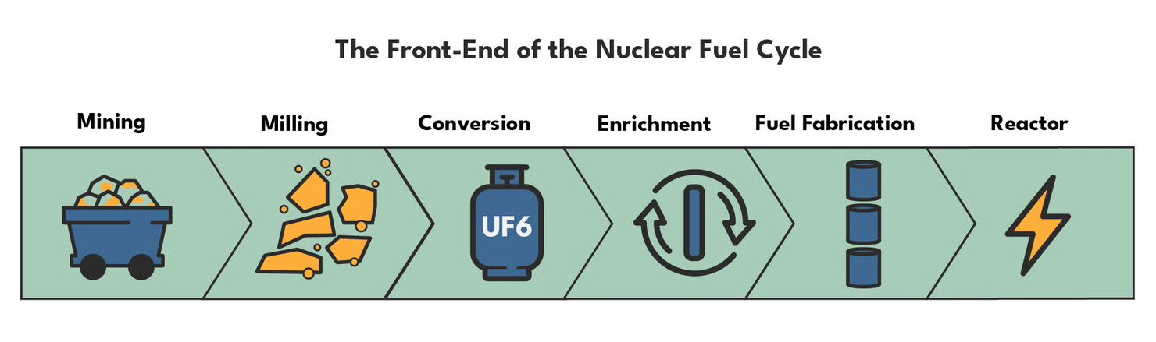
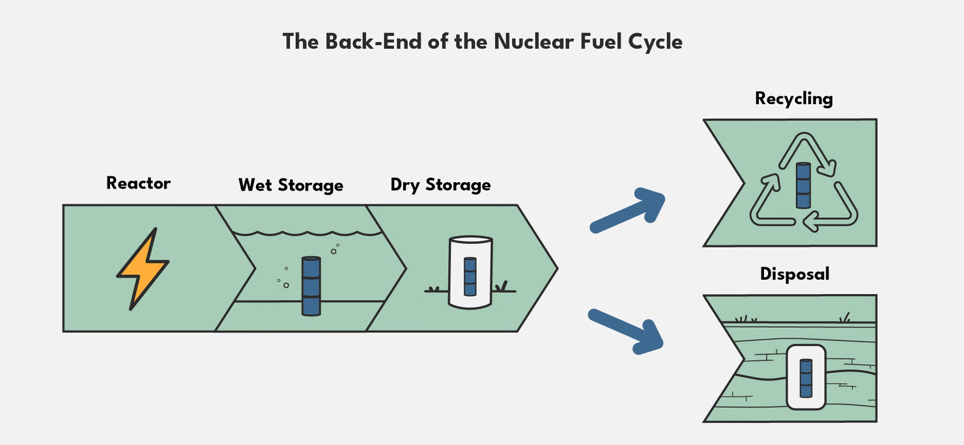
01 · COMPANY OVERVIEW
Cameco Across the Nuclear Fuel Cycle
Major Front-End Player
Direct operations in uranium mining, refining, conversion, and fuel manufacturing
More than just mining
Uranium supply security, conversion bottlenecks, long-term utility contracting, and nuclear buildout
Notes:
The nuclear fuel cycle is split into both front and back end processes. front-end processes are mining, milling, refining, and other steps to prepare uranium for use in a reactor and back-end processes include reprocessing, waste management, and everything post consumption.
Cameco is a major player in the front-end nuclear space with direct operations in uranium mining, refining, conversion, and fuel manufacturing, and it has strategic equity exposure to nuclear technologies.
In other words, Cameco’s value is tied to uranium supply security, conversion bottlenecks, long-term utility contracting, and nuclear buildout, not primarily just mining.

Slide 5
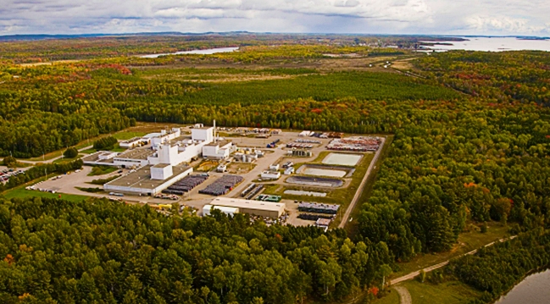
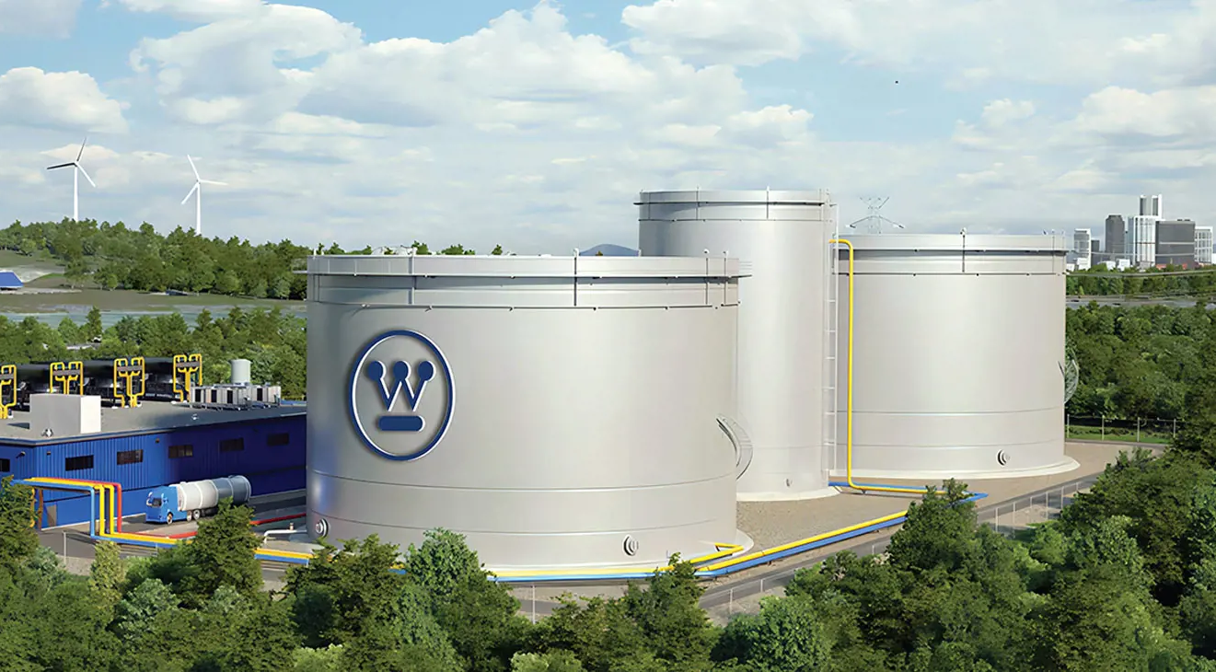
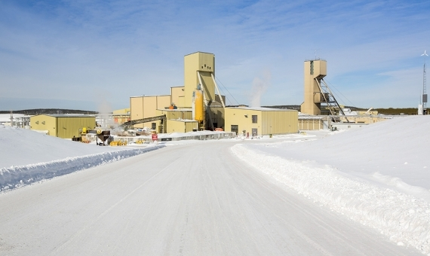
01 · COMPANY OVERVIEW
Cameco notable assets
Blind River Refinery
Westinghouse Electric
Cigar Lake
Notes:
Some of Cameco’s most notable assets include the Blind River refinery in Ontario, which is the world's largest commercial uranium refinery, Cigar Lake, which is the world's highest grade Uranium mine, and a 49% ownership stake in Westinghouse Electric, who supplies the technology used in about half the operating nuclear power plants worldwide
The takeaway here is that Cameco monetizes nuclear fuel demand through contracted uranium sales, fuel services, and strategic downstream exposure — making it more diversified than a pure uranium miner.

Slide 6
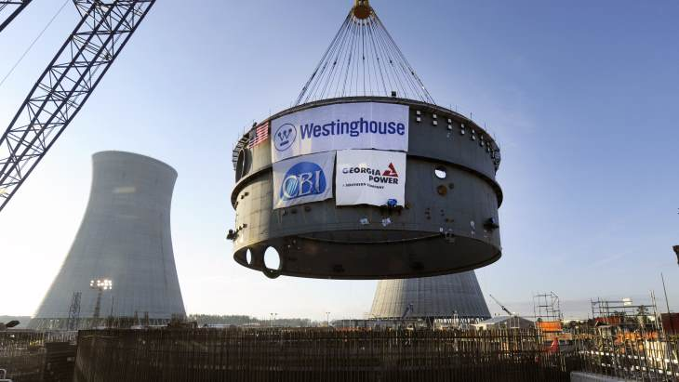
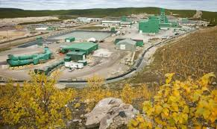
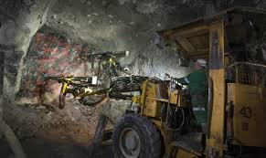
01 · COMPANY OVERVIEW
Cameco Business Model
03
Uranium Sales
Long term contracts
Older contracts reset at higher prices
Downstream Exposure
49% ownership in GLE and Westinghouse
Concerned with broader nuclear buildout
01
02
Fuel Services
More than just commodity value
More services = stronger business relationships
Notes:
On the front end, Uranium goes through a whole process before it can be used for energy. Uranium is mined → refined → converted → fabricated into fuel → before finally being used in reactor
Cameco’s business model can be subdivided into three distinct buckets. Uranium sales which includes mining and selling to nuclear utilities (raw materials) , fuel services which includes refining and conversion (usable fuel), and downstream exposure.
Uranium sales is a core driver in Cameco’s business model. It’s important to note than uranium is not mostly sold through a daily exchange. The company acknowledges that the uranium market is mostly based on bilaterally negotiated long-term contracts with only a small spot market to meet discretionary demand.
The company can benefit as time goes on since older contracts will be reset at higher prices.
Its involvement in fuel services makes Cameco’s value less directly tied to the value of a commodity. End users care about a usable product, and because of Cameco’s involvement in not only providing a raw material, but also processing services, relationships between key utilities can be strengthened as Cameco provides more value to its customers.
Downstream industry exposure through equity positions like its 49% ownership in Westinghouse Electric and GLE Global Laser Enrichment further allows Cameco to capture value downstream from their core operations of uranium sales. Exposure in these companies makes cameco not only concerned with uranium prices, but also reactor services, technological advancements, plant maintenance, and new build projects, giving Cameco the edge on a broader nuclear buildout.

Slide 7
02
Financial Analysis

Slide 8
02 · FINANCIAL ANALYSIS
Income Statement — FY2025 Audited
CAD millions · IFRS · Source: FY2025 40-F Exhibit 99.2
C$3,482M
C$970M
27.9%
C$618M
+11.0% YoY
+24.0% YoY
+290 bps YoY
+21.2% YoY
Revenue
Gross Profit
Gross Margin
Operating Profit
Line Item
FY2025
FY2024
Chg
Revenue
3,482
3,136
+11%
Cost of products & services sold
(2,219)
(2,072)
D&A
(293)
(281)
Cost of sales
(2,512)
(2,353)
+6.7%
Gross Profit
970
783
+24.0%
Gross Margin %
27.9%
25.0%
+290 bps
Operating expenses
(352)
(273)
Earnings from Operations
618
510
+21.2%
Finance costs / FX / Derivatives (net)
(59)
(244)
Share of earnings — equity investees
216
(11)
swing
EBT
777
257
+203%
Tax
(188)
(85)
Net Earnings
590
172
+243%
EPS (Basic)
C$1.35
C$0.40
+C$0.95
Notes:
Key: 'Share of earnings from equity-accounted investees' = $216M in FY2025 (vs. -$11M in FY2024). This single line drove most of the EBT improvement — it captures Cameco's 49% share of Westinghouse net earnings, including the Dukovany-related upside. The FY2024 loss was purchase accounting noise, now largely resolved.

Slide 9
02 · FINANCIAL ANALYSIS
Segment Performance — FY2025 vs. FY2024
CAD millions · Adj. EBITDA is non-IFRS (see reconciliation slide)
Uranium
Fuel Services
Westinghouse (49%)
Revenue
2,874
+7%
Revenue
562
+22%
Revenue (suppl.)
3,458*
+20%
Gross Profit
803
+18%
Gross Profit
174
+64%
Net Earnings (loss)
58
swing
Gross Margin
27.9%
+250bps
Gross Margin
30.9%
+780bps
Adj. EBITDA
780
+61%
EBT
954
+6%
EBT
179
+66%
Cash Dist. Received
US$221M
first ever
Adj. EBITDA
1,255
+6%
Adj. EBITDA
219
+51%
2026 Adj. EBITDA Outlook
US$370-430M
Adj. EBITDA Margin
43.7%
-40bps
Adj. EBITDA Margin
39%
+700bps
Capex (49%, USD)
US$120-150M
Capex (PP&E)
268
Capex (PP&E)
57
*Not in consolidated revenue
Notes:
Fuel Services is the biggest surprise — gross margin expanded 780 bps to 30.9% as UF6 conversion term prices hit multi-year highs (27% average annual increase per FY2025 MD&A). Westinghouse FY2024 net loss of ($218M) was pure purchase accounting noise, now resolved. 2026 Westinghouse adj. EBITDA ~US$400M midpoint is lower than FY2025's $780M because FY2025 included a one-time US$170M Dukovany advance payment.

Slide 10
02 · FINANCIAL ANALYSIS
Non-IFRS Reconciliation
Source: Q4 2025 Earnings Release · CAD millions
Adjusted Net Earnings (ANE)
Adjusted EBITDA by Segment
Company definition: Net earnings adjusted for non-operating/non-cash items: derivatives, unrealized FX, share-based comp, reclamation provision changes, and equity investee purchase accounting.
EBITDA = Net earnings + D&A + finance costs − finance income + income taxes. Adj. EBITDA further excludes non-recurring/non-operating items and adds back equity investee EBITDA components.
FY2025
FY2024
Segment
FY2025
FY2024
Chg
Net earnings (IFRS)
590
172
Adjustments on derivatives
(144)
152
Uranium
1,255
1,179
+6%
Unrealized FX losses (gains)
54
(66)
Fuel Services
219
145
+51%
Share-based compensation
79
44
Other operating expense adj.
(22)
(35)
Westinghouse
780
483
+61%
Income taxes on adjustments
22
(46)
Investee: inventory purchase acctg
8
53
Corporate/Other
(325)
(276)
Investee: acquisition costs
—
22
Total Adj. EBITDA
1,929
1,531
+26%
Investee: unrealized FX
18
(7)
Investee: LTI plan
22
3
Adjusted Net Earnings
627
292
Notes:
Note: In FY2024 Cameco revised ANE to also exclude unrealized FX and share-based comp — comparative periods restated. Adj. EBITDA 'margin' on consolidated revenue of $3.48B = 55%, but this is misleading because Westinghouse $780M EBITDA is included while its ~$3.46B revenue is excluded from the top line.

Slide 11
02 · FINANCIAL ANALYSIS
Balance Sheet & Cash Flow — FY2025
CAD millions · Source: FY2025 Consolidated Audited Financial Statements
Balance Sheet (Dec 31, 2025)
Cash Flow Statement (FY2025)
Cash & equivalents
1,115
Net earnings
590
Short-term investments
100
D&A
293
Total cash + STI
1,215
Dividends from equity investees*
447
Accounts receivable
360
Working capital & other
78
Inventories
844
Cash from Operations
1,408
Total current assets
2,639
PP&E (net)
3,325
PP&E additions (Capex)
(333)
Investment in equity investees
2,987
Short-term investments
(100)
Deferred tax assets
666
Net cash used in investing
(434)
Total assets
10,301
Total current liabilities
1,070
Debt repayment (US$200M TL)
(285)
Current LT debt
—
Dividends paid
(104)
Net cash used in financing
(443)
Long-term debt
996
Total shareholders' equity
6,903
Net increase in cash
532
NET CASH POSITION
~218
*Westinghouse distributions (US$221M) + JV Inkai dividend (US$87M) flow here
Implied FCF (Ops − Capex)
~1,075
Notes:
Net cash ~$218M (cash $1,215M − LT debt $996M). Note: Westinghouse and JV Inkai capex NOT in consolidated capex — they are equity-accounted. Consolidated capex of $333M is Cameco's own mining and fuel services assets only. Westinghouse capex (49% share) was guided at US$120-150M separately.

Slide 12
02 · FINANCIAL ANALYSIS
Operational KPIs — FY2025
Source: Q4 2025 Earnings Release
US$62.11
33.0M lb
21.0M lb
C$43.04
C$87.00/lb · +9% YoY
vs. 33.6M lb in FY2024
Cigar Lake: 19.1M (+1.1M vs. guidance)
+14% YoY · record conversion pricing
Avg. Realized Price
(Uranium, FY2025)
Uranium Delivered
(FY2025)
Uranium Produced
(Cameco share)
Fuel Svcs Realized
Price per kgU
Notes:
McArthur River produced only 15.1M lb (100% basis) in FY2025 vs. 20.3M lb in FY2024 — development delays (Zone 1/Zone 4 clay). Cigar Lake offset partially. JV Inkai recovered to 8.4M lb (100% basis); 2026 guidance = 10.4M lb full capacity (Cameco share: 4.2M lb purchased).

Slide 13
03
Valuation
High-level multiples · Peer comps · DCF analysis · Price target framework
Notes:
I’m presenting Section 3, Valuation. We’ll cover three complementary approaches: first, a comparable company analysis benchmarking CCJ against its closest public peers; second, a DCF model to understand the consolidated free cash flow floor; and third, a multiples-based price target framework.
The headline takeaway from this section: a pure consolidated DCF implies roughly $19 per share versus a $104 market price. That gap is not an error — it’s a decomposition. The market premium reflects Westinghouse equity value, uranium price optionality, and the structural nuclear renaissance, none of which appear in CCJ’s consolidated free cash flow. By the end of this section you’ll understand exactly what the market is pricing in and why it may or may not be justified.

Slide 14
03 · VALUATION
Valuation — Multiples & Peer Comps
CCJ US$104.49 · June 28, 2026 · Sources: stockanalysis.com, Cameco FY2025 40-F, company filings
KAP EV/EBITDA
EV / Adj. EBITDA (Co.)
BWXT EV/EBITDA
9.5x
~32x
42.3x
Kazatomprom (LSE:KAP) · Pure-play uranium mining · World’s lowest-cost major producer
CCJ EV US$45.4B · Adj. EBITDA ~US$1.41B (C$1,929M at ~0.73 FX)
BWX Technologies (NYSE:BWXT) · Nuclear tech & reactor services · Best comp for Westinghouse
Comparable Company Analysis · Sources: stockanalysis.com, company filings · As of June 28, 2026 · *CCJ EV/EBITDA on LTM basis (unadjusted, peer-comparable); on Company Adj. EBITDA incl. 49% Westinghouse look-through, ~32x
Company
Ticker
Mkt Cap
EV/EBITDA
P/E (trailing)
EV/Revenue
Comment
Cameco Corp.
CCJ
US$45.4B
~71x*
~97x
17.9x
BUY · Uranium + Fuel Services + Westinghouse (49%)
Kazatomprom
KAP
US$15.5B
9.5x
9.5x
4.7x
World’s largest uranium producer; state-owned; Kazakhstan
BWX Technologies
BWXT
US$18.1B
42.3x
52.8x
5.8x
Nuclear technology & reactor services; Westinghouse analog
Paladin Energy
PDN
US$2.8B
N/M
N/M
12.2x
Namibia uranium restart; gaining scale as FY2026 first full production year
Notes:
"On a like-for-like basis with peers, CCJ trades at ~71x EV/EBITDA — expensive, but that's comparing Cameco's reported operating EBITDA against peers who don't have a Westinghouse. On the company's own Adjusted EBITDA, which includes Westinghouse's earnings, that drops to ~32x, in line with BWXT. The premium is the market paying for optionality peers don't have."
"Every peer in this table gives you one piece — uranium exposure, or reactor exposure, or conversion exposure. CCJ is priced at a premium because it's the only name that gives you the whole fuel cycle in one stock, plus a call option on the US nuclear buildout through Westinghouse that none of the pure-plays have at any price."

Slide 15
03 · VALUATION
DCF Analysis — What the Fundamentals Say
WACC: 9.79% · Terminal growth: 3.0% (base) · Shares: 435.5M · Net cash: US$70.7M · Source: CCJ DCF Model, June 2026
WACC
Terminal Growth
Base DCF Price
9.79%
3.0%
~$19
CAPM: 4.40% Rf + 0.98β × 5.50% ERP · Near net-cash position → ~100% equity weight
Base case · GDP+ reflecting nuclear energy structural demand growth
Consolidated FCF only · ~82% below US$104 market · Westinghouse equity value not in FCF
DCF Scenario Analysis · FY2026–FY2030 · Consolidated FCF (Westinghouse equity-accounted, not in revenue)
Scenario
Rev CAGR
EBITDA Margin
WACC
Terminal g
DCF Price
vs. Market
Bear
~3%
25–27%
10.5%
2.0%
~US$9
(91%)
Base
~9%
27–33%
9.8%
3.0%
~US$19
(82%)
Bull
~13%
30–38%
9.0%
4.0%
~US$39
(63%)
Market Price
—
—
—
—
US$104.49
Premium = Westinghouse NAV + uranium optionality + new nuclear build pipeline
Notes:
"This DCF only values uranium and fuel services — Westinghouse is excluded entirely because it's equity-accounted, not consolidated. Base case is $19, roughly 80% below the market price, and that's expected: it's deliberately a floor on one piece of the business, not a target for the whole company."
Unlevered FCF = EBIT × (1 − tax rate) + D&A − CapEx − ΔNWC

Slide 16
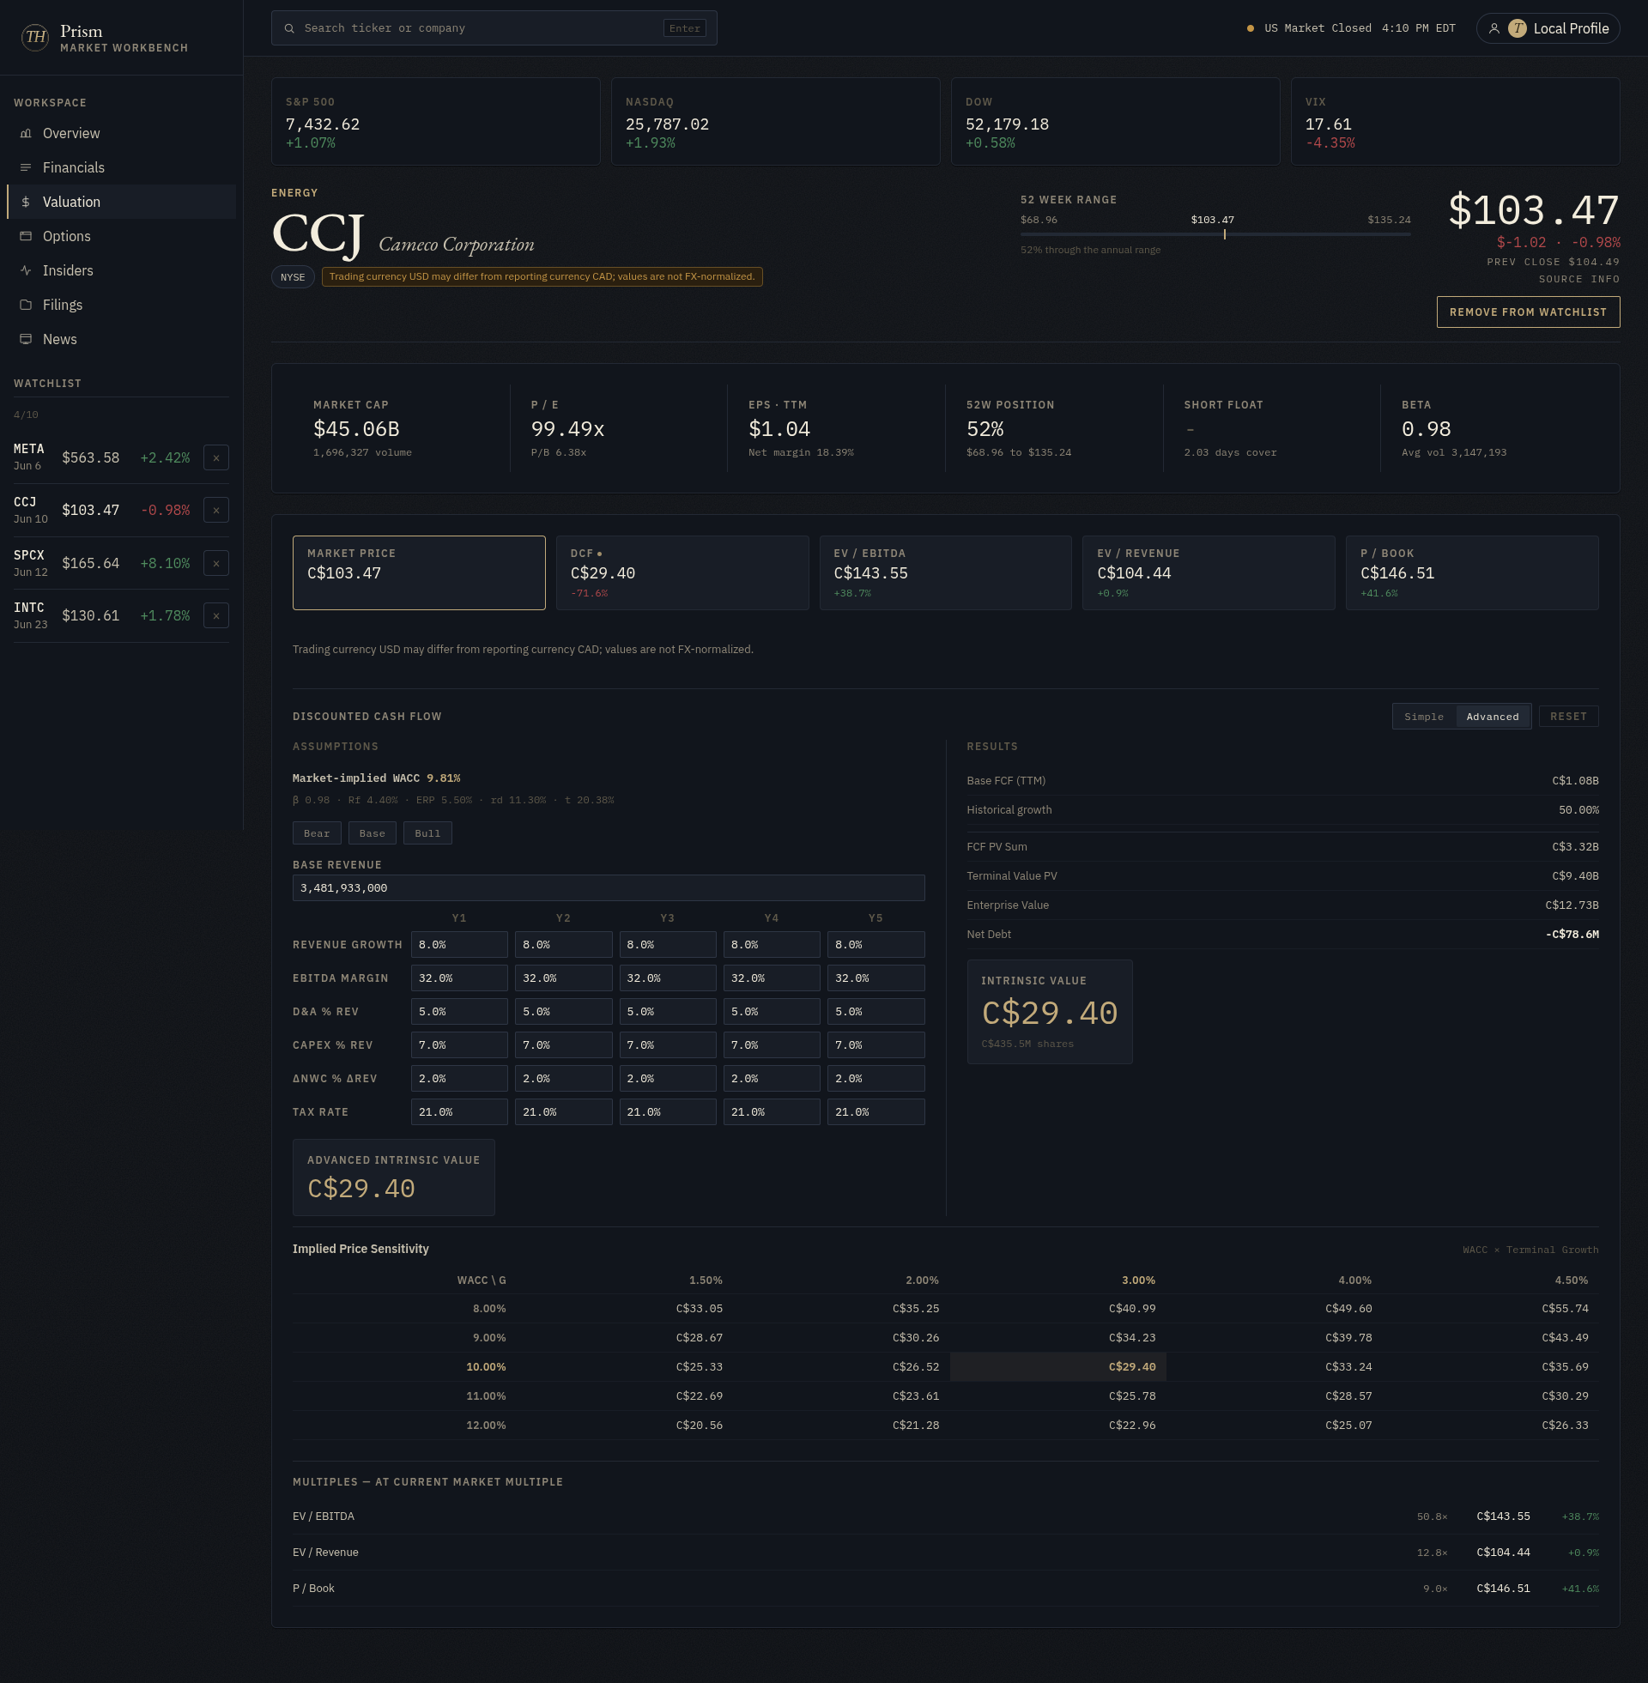
03 · VALUATION
DCF Cross-Check — Prism Sanity Check
Source: https://prism.tylerhoang.xyz · Independent sanity check with simplified assumptions — see prior slide for primary DCF
Notes:
"This is a quick independent sanity check using a separate tool, not a mirror of the primary model's assumptions — it lands in a similar conservative range, which is the point: two different builds agree the core business alone is worth a fraction of where the stock trades."

Slide 17
03 · VALUATION
DCF Cross-Check — Prism Sensitivity Table
Source: https://prism.tylerhoang.xyz · Prism’s own assumptions — see prior slide for primary DCF
Notes:
"Same story across a range of WACC and growth assumptions — even the most generous combination here stays well under market price, reinforcing that the market price isn't being justified by the core uranium business on a standalone basis."

Slide 18
03 · VALUATION
Price Target Framework
12-month view · EV/Adj.EBITDA approach · Adj. EBITDA includes Westinghouse 49% proportionate contribution
EV/Adj.EBITDA Sensitivity — FY2026/27E Forward Adj. EBITDA Scenarios
Current stock ~US$104 · Shares ~435M · Net Cash ~CAD$218M · USD/CAD ~0.73 assumed
Scenario
Fwd. Adj. EBITDA (CAD$)
EV/EBITDA Multiple
Implied EV (CAD$)
Implied Price (US$)
vs. Current
Bear
C$1,600M
28x
~C$44.8B
~US$75
-28%
Base
C$2,100M
32x
~C$67.2B
~US$113
+8%
Bull
C$2,600M
36x
~C$93.6B
~US$157
+51%
Notes:
"This flips the approach: instead of discounting cash flows, we apply a market multiple to forward Adjusted EBITDA, which already includes Westinghouse's earnings. Because the multiple itself comes from where the stock trades today, this framework naturally lands close to market price — Base case ~$113, roughly in line with current trading."

Slide 19
03 · VALUATION
Uranium Operating Leverage & Contract Book
FY2026 guidance: C$85–89/lb avg realized · ~29–32M lb deliveries · Each C$1/lb = ~C$30M gross profit impact
Uranium Price Sensitivity
Contract Book Signal
~C$150M
~230M lb
gross profit per C$5/lb realized price move × ~30M lb deliveries
under long-term contract (as of June 2026)
C$1/lb × ~30M lb = C$30M · 2026 guidance: C$85–89/lb avg realized · Each C$5/lb upside = ~C$150M gross profit
~28M lb/yr avg · next 5 years
~25% of reserves/resources committed
Note: Westinghouse adj. EBITDA guided US$370–430M in FY2026 vs. C$780M in FY2025 (~US$568M at ~0.73 FX). FY2025 included one-time US$170M Dukovany advance payment — FY2026 adj. EBITDA may be C$200–300M below FY2025’s C$1,929M. Forward EBITDA scenarios in the price target framework reflect this normalization.
Notes:
"The takeaway here is sensitivity: every $5/lb move in realized uranium price swings gross profit by about $150 million, and with only a quarter of reserves committed long-term, Cameco is holding back supply for exactly this kind of repricing as contracts roll off."
"Cameco has locked in about 230 million pounds of future deliveries, but has deliberately committed only around a quarter of its total reserves — holding the rest back rather than contracting it away at today's prices. That's what lets old, cheap contracts keep rolling off and getting replaced at much higher prices as the cycle plays out, and each $5-per-pound move in realized price is worth about $150 million of gross profit once you apply it across roughly 30 million pounds of annual deliveries."

Slide 20
04
Investment Catalysts
& Growth Drivers

Slide 21
04 · CATALYSTS
Why Invest in Cameco Today?
Source: FY2025 MD&A · Q4 2025 Call Transcript · FY 2025 AIF
1
Tight Uranium Supply
2
Growing Nuclear Demand
Kazakhstan cuts production
Uranium price at 14-year high
Limited supply, growing demand
Clean energy transition
AI & Data Center growth
Higher uranium demand
3
Beyond Uranium Mining
49% stake in Westinghouse
Nuclear reactor technology & service
New long-term earnings driver
Notes:
Now let's look at why we recommend Cameco.
Our investment thesis is built on three key catalysts.
First, uranium supply is tightening. Major producers are cutting production, supporting higher uranium prices and giving Cameco stronger pricing power.
Second, demand is growing. More countries are investing in nuclear energy, while AI and data centers continue to increase electricity demand.
Finally, beyond uranium mining, Cameco also benefits from its 49% stake in Westinghouse, creating another long-term growth opportunity.
Together, these three catalysts support our BUY recommendation for Cameco.

Slide 22
05
Risks &
Conclusion

Slide 23
05 · RISKS
Key Risks to the Investment Thesis
Source: FY2025 MD&A · Q4 2025 Call Transcript · FY2025 AIF
McArthur River Production Risk
HIGH
Uranium Spot Price Volatility
HIGH
Produced only 15.1M lb (2025) vs. 20.3M lb (2024 record). Zone 1/Zone 4 clay development delays. 2026 guide implies ~14M lb (100% basis). Extended Key Lake maintenance shutdown in 2026. Three consecutive years of guidance compression — not fully resolved.
FY2025 spot averaged US$73.54/lb — volatile. Significant spot decline would pressure contract floor negotiations and reduce near-term contract economics. CCJ earnings highly levered to realized price: ~C$150M gross profit per C$5/lb swing × ~30M lb deliveries.
Kazakhstan / JV Inkai Geopolitical Risk
HIGH
Westinghouse US Partnership Execution Risk
MED
JV Inkai production halted Jan 1, 2025 (regulatory surprise; resumed Jan 23). Sulfuric acid supply remains a chronic constraint. New Mineral Extraction Tax impacts cost structure. Lease extends to 2045 but Kazakhstan remains a higher-risk jurisdiction.
No definitive agreement signed as of Q4 2025 call (Tim Gitzel flew to Washington on earnings day). Depends on US government funding through appropriations process, executive order enforcement, Japanese foreign direct investment. Many unknowns; not in guidance.
Below-Replacement-Rate Contracting
MED
Currency / Tax Risk
LOW
2025 industry term contracting was 116M lb — still below ~160M lb replacement rate. If utilities continue to delay, Cameco's realized price improvements will lag. Management's 'disciplined wait' strategy requires patience from investors.
Cameco reports in CAD; sells uranium in USD. CAD strengthening reduces realized revenue in reporting currency. CRA (Canada Revenue Agency) transfer pricing dispute ongoing for 2018+ tax years — though courts have sided with Cameco in resolved years.
Notes:
McArthur River risk is the most material near-term fundamental risk — not captured in most sell-side models that assumed 18M lb/yr. It's partly a market strategy (Cameco deliberately not accelerating) and partly a genuine technical challenge. Key question for due diligence: when does Zone 4 fully come online and at what cost?

Slide 24
05 · CONCLUSION
Our Recommendation
CCJ: BUY
1
Irreplaceable asset base —
Largest high-grade uranium reserves globally (McArthur River licensed to 25M lb; Cigar Lake world's highest grade). No near-term comparable exists.
2
Structural supply deficit accelerating —
Kazatomprom cutting 2026 output by ~12M lb. Cigar Lake mine life ends ~2036 (10% of global supply). No new tier-1 mines funded. Supply tightness is structurally durable.
3
Re-contracting cycle will drive realized price higher —
~2.1B lb of uranium still unpurchased by utilities through 2040. 116M lb contracted in 2025 — well below replacement rate. Contract repricing from low 2020-era prices to C$80–90+ is only beginning.
4
Westinghouse: 40% of adj. EBITDA and growing —
C$780M adj. EBITDA (FY2025). US$80B government partnership. Per AP1000 two-pack: US$800M–US$1.2B EBITDA through engineering/procurement phase. Massively underfollowed by uranium-only investors.
5
Strong balance sheet, disciplined management —
Net cash ~C$218M. C$1.4B operating cash flow (FY2025). Term loan extinguished. Dividend growing (C$0.24/sh). Management explicitly refuses to front-run demand with supply — cycle-tested discipline.
2026 Guidance: 29–32M lb deliveries · C$85–89/lb realized price · Westinghouse Adj. EBITDA US$370–430M (49%) · BUY
Notes:
Closing message: CCJ is the highest-quality, most liquid uranium equity. It owns the supply chain bottleneck (tier-1 mines), the downstream growth engine (Westinghouse), and has discipline not to sell its future cheap. The BUY case doesn't require a uranium supercycle — it just requires the market to finish buying the uranium it has already committed to use.

